Slide 1
UNIT 9: CONSTRUCTS OF GAME DESIGN

Slide 2
UNIT DESCRIPTION
In this unit of study, learners will explore concepts fundamental
to the ideal level design. Learners will understand the principles
of navigation and the importance of a balanced layout to pro-
viding good game flow. Learners will also explore principles of
functionality.

Slide 3
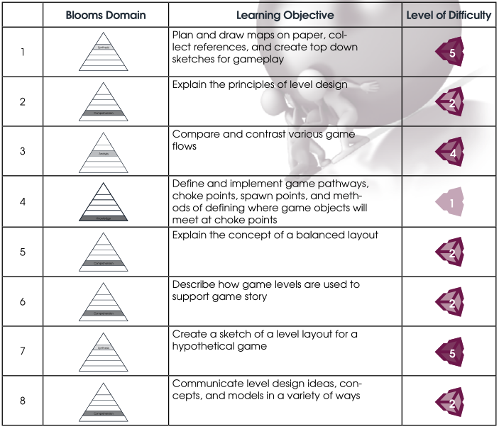
LEARNING OBJECTIVES
By the end of this unit, learners should be able to perform the following tasks:

Slide 4
COURSE OUTLINE

Slide 5



1. Level Design Theory
a. Game flow types
b. Creating a balanced layout
c. Support of the game narrative
d. Conveying the design

Slide 6
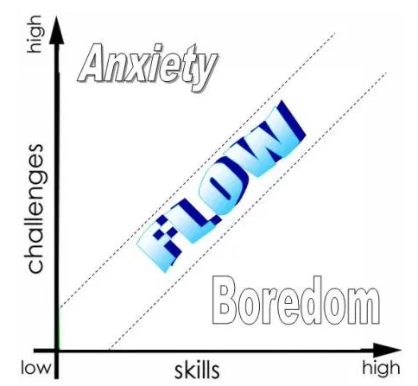
Elements of Flow
A challenge activity that requires skills
The merging of action and awareness
Clear goals
Direct feedback
Concentration on the task at hand
The sense of control
The loss of self-consciousness
The transformation of time

Slide 7
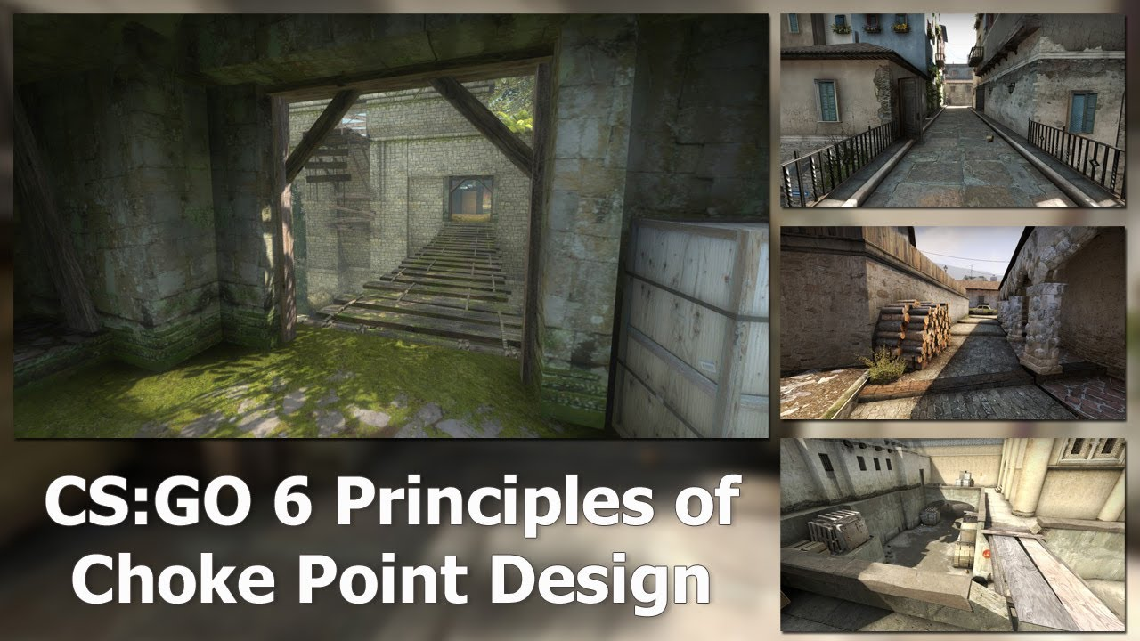

Slide 8
2. Level Design
a. The big idea
b. From research to reference
c. Creating the floor plan(s)
d. Game Play elements
e. Objects
f. Other effects (lighting, sound, etc)

Slide 9
A Beginner's Guide to Designing Video Game Levels
Step 1: Understanding Constraints
Step 2: Brainstorming and Structure
Step 3: Bubble Diagrams
Step 4: Rough Maps
Step 5: Finishing the Design

Slide 10
Step 1: Understanding Constraints
How Long Should This Level Be?
Are We Trying to Show off Any New Tech, Art, Audio, or Similar?
How Much Time Do I Have to Design It?
If Someone is Paying For This Game, What Are Their Requirements?
What Platform is It On?
Where Does This Level Fit Into the Level Progression?
Who is the Audience?

Slide 11
The Most Critical Constraints
What is Required by the Story, Theme, or Plot?
The goal of the example level is to rescue a VIP who is trapped in a military facility, then leave the area in a helicopter.
What Are My Set-Pieces?
Dark hallways and stairwells show our lighting off to good effect. Employ surprise to prompt weapon firing, which will cast cool shadows.
Fight a huge monster in a destroyed barracks near the middle.
A Control Tower where the VIP is located.
What Metrics Am I Bound By?
Each area that you design needs to take into account things like the player's movement speed, the size of the player, the size of the monsters, jump heights, and so on.
Each of these informs how large your corridors and spaces need to be, and what heights and lengths are available to be used as jumps.
What Does the Game's Macro Design Require From This Level?
A Macro document specifies which puzzles and enemies go in each level, how many usages of each are expected per-level, what rewards you get, and things of that nature. This puts further constraints on your design.

Slide 12
For the sake of our example, here are our Macro constraints:
First: this is a simple first-person combat game. No puzzles, and simple combat with four enemy types:
Ranged: An enemy that stands still and shoots at the player.
Melee: An enemy that runs up close and attacks the player with a weapon.
Swarmer: A small, close-range enemy with a single hit point. Good in swarms.
Heavy: A large enemy that stands still, takes lots of hits to kill, does lots of damage, and has both a ranged attack and a melee attack.
Second: once the player has rescued the VIP, there needs to be a shortcut back to the start of the level, so the player doesn't have to re-traverse the whole thing.
Third: the VIP is located in the final combat room. She is being held prisoner by elite soldiers.

Slide 13
Step 2: Brainstorming and Structure
Coming Up With Ideas
Narrowing It Down to Areas
For the example level, this is what I came up with for areas:
Helicopter Landing Pad: Start of level; safe—no enemies.
Computer Room: One combat encounter with two Ranged enemies; the path behind you closes off somehow (one way).
Tight Corridors: Four combat encounters; introduce the Melee and Swarmer enemies.
Destroyed Barracks: One combat encounter; introduce the Heavy Enemy; tight quarters.
Barracks 2: The path behind you closes off somehow; one encounter with Melee, Ranged, and Heavy enemies.
Corridors 2: One encounter with Melee and Ranged enemies.
Large Stairwell: Vertical fight against enemies; three encounters using all four enemy types.
Damaged Control Tower Room: One encounter with two Heavies and some Swarmers as a final fight; we need a one-way exit back to the start; the VIP itself is located between this room and the shortcut to the start.

Slide 14
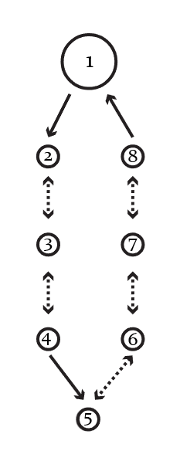
Step 3: Bubble Diagrams
A Bubble Diagram is a very simple map of the whole level, with circles indicating areas in the level and arrows indicating the flow and connections between the areas.

Slide 15
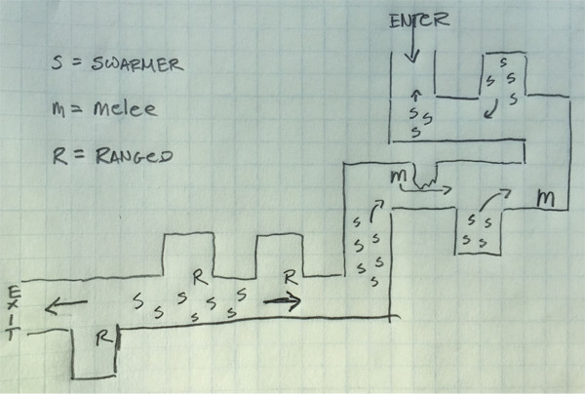
Step 4: Rough Maps
Flesh out Each Bubble
Below, see an example of what one of the bubbles (specifically Bubble 3: Tight Corridors) looks like after I've designed it out on paper (top-down):
Player comes south and fights 3 Swarmers. After player rounds the corner, four more Swarmers run out from an alcove.
After rounding the second corner, the player is face-to-face with a Melee enemy. This enemy will need to close distance before attacking, so having it around the corner isn't cheap.
Rounding the third corner, the player fights a horde of Swarmers, along with a single Melee enemy that runs from behind cover to attack. The Swarmers come from inside the alcove close to the player, and from around the next corner.
The player passes the fourth corner and turns the fifth corner to be confronted by three Ranged enemies, each using the wall as cover, while five Swarmers run at the player.
Rounding the last corner, the player proceeds to the area in Bubble 4.

Slide 16
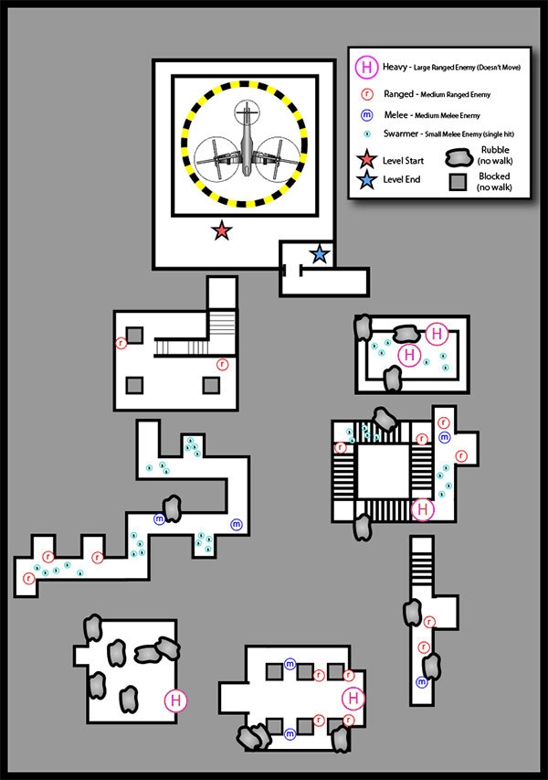
Connect the Areas Together

Slide 17
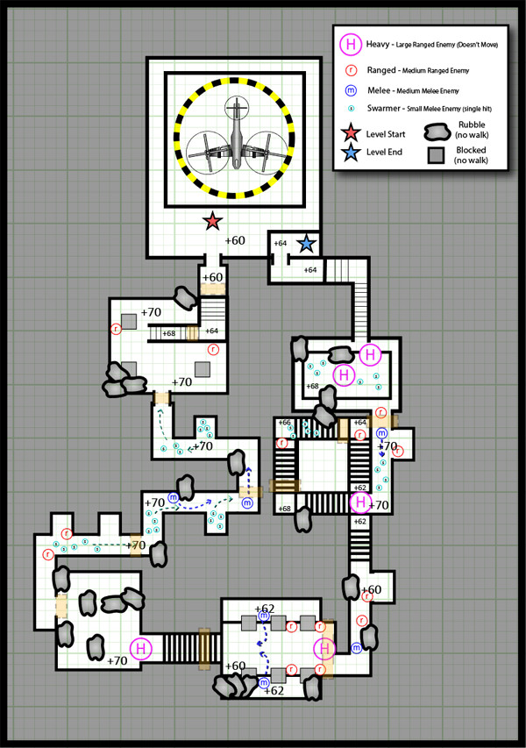
Step 5: Finishing the Design

Slide 18
3. Understanding the flow of space: explore how players tend to move through space in several different situations
a. 2D platformers
b. 3D first person shooters
c. 3D narrative spaces.

Slide 19
Additional Unity Skill Development
In this activity, learners will experience many topics within level design, including: viewpoints, balance, and functionality. The tutorials listed below examine these topics in detail:
1. Joints:
https://unity3d.com/learn/tutorials/topics/physics/physics-joints?playlist=17120
2. Raycasting:
http://unity3d.com/learn/tutorials/modules/beginner/physics/raycasting
3. OnCollisionEnter:
http://unity3d.com/learn/tutorials/modules/beginner/physics/on-collision-enter
Some learners may have already included physics components in the Capstone Project at this point. As a result, some learners may desire additional time to adapt, tweak, or update previous work.

Slide 20
Design Document (GDD) Entry -1
In your Game Design Document (GDD), complete sections 2.8 - Design and 2.81 - Copy.
For each level, be sure to include the following:
• World Description
• Location
• Time of day: Does it stay the same or change?
• Weather: Does it stay the same or change?
• Are there any pertinent terrain features?
For the story setup, consider the following:
• What main story points set up the player for the current level or mission?
• Story continuity: How does this level support the overall storyline of the game?
• Story points that are reinforced with this mission or level.

Slide 21
Design Document (GDD) Entry -2
Mission or level summary
• Textual summary of walk-through description of mission or level.
• Topographic map
• Specific objectives or goals: What does the player need to accomplish – what are the challenges of the level?
Opening Scene
• What non-player characters are present and what is their purpose? Note: This may overlap enemies.
• What entities are present in the opening scene for the level?
• Are there any special effects like fireballs, erupting geysers, jagged lighting in the sky or anything else to note
about the opening scene?
• How will sound and music be used, if at all?
Gameplay notes for the level
• Clear rules of gameplay
• Special considerations, exceptions and implications

Slide 22
Capstone Project
At this point, you should be actively building your Capstone Project in Unity. Now is time to create your design levels! Use this opportunity to apply the learning you received about level design and balance within the game you are creating. By this point, you should have enough content to begin integrating objects. You may also be ready to begin adding animations. Lastly, you can also add physics to objects to improve their game performance and realism. As game development is progressing, your game designs should also be coming together. Just remember, you may need to return to update, tweak, or revise your project. That is no cause for concern. Design iteration is a natural part of the game development process!

Slide 23
WEEKLY ASSIGNMENT
CREATE A BUBBLE DIAGRAM OF YOUR CAPSTONE PROJECT.
CREATE THE ROUGH DRAFT/SKETCH OF EVERY AREAS IN YOUR LEVEL DESIGN. TRY TO INTEGRATE ENEMIES/PUZZLE/OBSTACLE (MAKRO CONSTRAINT) IN YOUR GAME.

Slide 24
SUGGESTED RESOURCES
Which books, digital resources, & other materials will be used in this lesson? Listed below is a
recommendation of resources to consider for this unit:
6 Principles of Choke Point Level Design https://www.youtube.com/watch?feature=player_embedded&v=RO9ftM-_Vys & http://worldofleveldesign.com/categories/csgo-tutorials/csgo-principles-choke-point-level-design.php
How to Design Gameplay Map Layouts (Complete In-Depth Guide) https://www.youtube.com/watch?feature=player_embedded&v=YBTWe2xUcAM & http://worldofleveldesign.com/categories/csgo-tutorials/csgo-how-to-design-gameplay-map-layouts.php
Good level design reference database http://level-design.org/referencedb/index.php?/category/44
Bio of a level designer http://www.2d-chris.com/about/
Good overview of level design http://www.gdcvault.com/play/1020172/Level-Design-in-a-Day
(start with slide 25)

